Slide 1

Submitted by, Naseef (2AB20EC005) Amir Bin Mahfooz (2AB20EC003)
ANJUMAN INSTITUTE OF TECHNOLOGY AND MANAGEMENT
Department of Electronics and Communication Engineering
Mini Project Seminar on
Smart Medicine Box
Under the guidance of
Prof. Tasmiya Shaikh
Assistant Professor
Dept of ECE

Slide 2
CONTENTS
Abstract
Introduction
Literature Review
Problem Statement
Objectives
Methodology
Block Diagram
Circuit Diagram
Component details
Implementation
Result
Conclusion and Future Scope
References

Slide 3

ABSTRACT

Slide 4
ABSTRACT
Health related problems are becoming the major issue in today’s world.
Every other person seems to be undergoing more than one problem irrespective of the age, either that problem be related to heart or brain.
Such carelessness seen in the case of taking medicines might lead to results which are catastrophic and has direct impact onto the health of an individual.
This paper describes how with the help of smart box will an individual be able to take his medicines without any external human assistance.

Slide 5
INTRODUCTION

Slide 6
INTRODUCTION
Medication adherence is a growing concern throughout the healthcare industry with doctors, healthcare systems, and other stakeholders since the elderly or senior patients’ medication has a big issue of drugs misuse.
It is very likely for them to forget to take their pills on time. Especially, those who take multiple medications at the same time.
Also, they might take wrong dosage accidentally which may lead to unfortunate consequences such as death.
This is a clear proof that it is a widespread problem and clearly related to adverse patient outcomes and higher healthcare costs.
The main purpose of smart medicine dispenser system is to help the patients, primarily seniors, take their medications on time in an easy way without the possibility of missing pills.
It can also reduce the risk of over or under dosing accidentally.
The smart medicine box could solve such problems by informing and alerting the patients to take the appropriate dose at the right time.

Slide 7

LITERATURE REVIEW

Slide 8
LITERATURE REVIEW
1. Bhati, Sanjay, et al. "Smart medicine reminder box." IJSTE-International Journal of Science Technology & Engineering 3.10 (2017): 172-177 proposed that,
To make a Smart medicine box for those users who regularly take medicines and the prescription of their medicine is very long as it is hard to remember to patients and also for their care giver
Old age patients suffer from problems of forget to take pills on proper time which causes certain health issues for patients having Permanent diseases like diabetes, blood pressure, breathing problem, heart problems, cancer diseases etc.
These problems in hospitals & people around us who have such kind of diseases and thus based on these two problems we made smart medicine box which solve these problems by Setting up timetable of prescribed medicines through push buttons as given in prescription

Slide 9
LITERATURE REVIEW
2. Diaa Salama Abdul Minaam, Mohamed Abd-ELfattah, “Smart drugs: Improving healthcare using Smart Pill Box for Medicine Reminder and Monitoring System”, Future Computing and Informatics Journal, Volume 3, Issue 2, 2018, Pages 443-456, ISSN 2314-7288 proposed that ,
Many medical errors are due to the fact that people in charge of patient or elder's medication have to deal with sorting huge amounts of pills each day.
This medication pill box is focused on patients who frequently take medications or vitamin supplements, or attendants who deal with the more seasoned or patients
The warning of pills should be taken will be shown by an android application which is held by the patient.

Slide 10
PROBLEM STATEMENT

Slide 11
PROBLEM STATEMENT
Many patients take medicines at different times of the day.
In a large setting , it would be difficult for the doctors and nurses to properly track the progress.
By integrating internet technology, we can keep track of the progress of all the patients on a single device.

Slide 12
OBJECTIVES

Slide 13
OBJECTIVES
The project is expected to fulfil features as listed below:
To design and create a prototype which will enable the owner to track every pill to ingest in an easy and simple way requiring no training or complex learning from their side in order to operate the device
To remind the elder patients to take their pills at the specified times.
Designed to prevent errors in hospitals and retirement homes where many pills must be given daily to each one of the patients.

Slide 14
METHODOLOGY

Slide 15
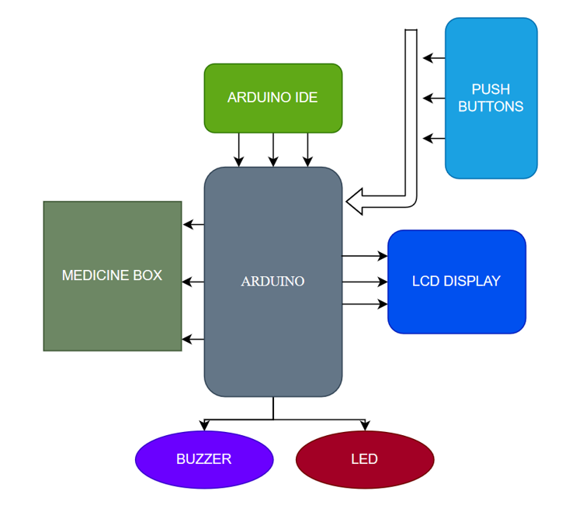
BLOCK DIAGRAM

Slide 16
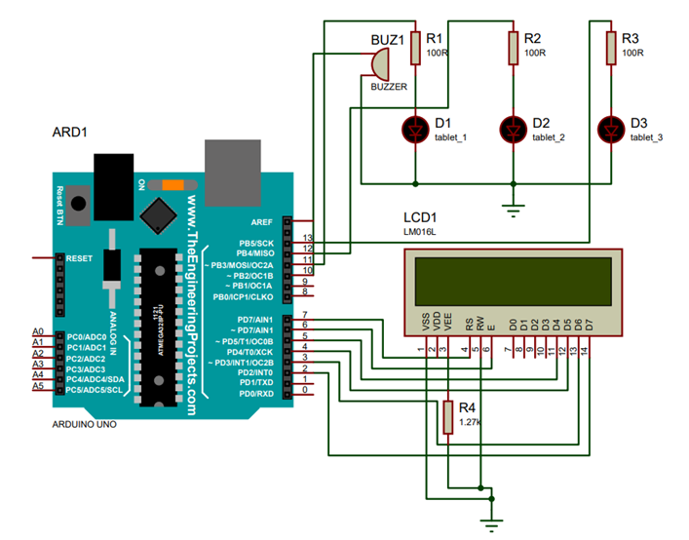
CIRCUIT DIAGRAM

Slide 17

COMPONENT DETAILS
HARDWARE
Arduino Uno
LCD
Buzzer
RTC
SOFTWARE
Arduino IDE

Slide 18
COMPONENTS

Slide 19
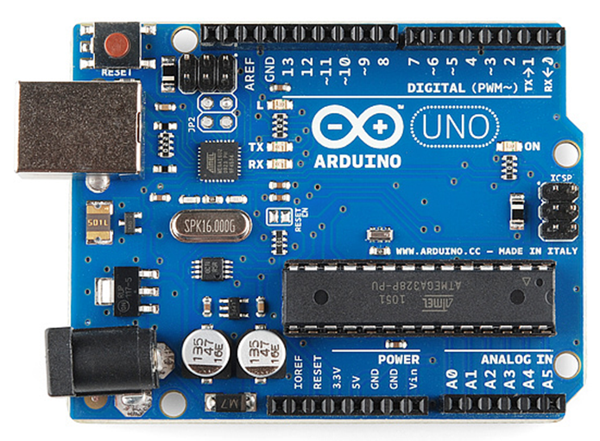
ARDUINO UNO
The Arduino UNO is a standard board of Arduino. Arduino UNO is based on an ATmega328P microcontroller. It is easy to use compared to other boards, such as the Arduino Mega board, etc.
The Arduino UNO includes 6 analog pin inputs, 14 digital pins, a USB connector, a power jack, and an ICSP (In-Circuit Serial Programming) header.
This board can be interfaced with other Arduino boards, Arduino shields, Raspberry Pi boards and can control relays, LEDs, servos, and motors as an output.

Slide 20
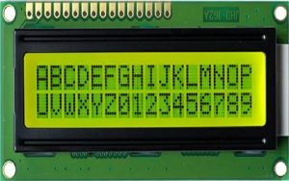
LIQUID CRYSTAL DISPLAY
An electronic device that is used to display data and the message is known as LCD 16×2. As the name suggests, it includes 16 Columns & 2 Rows so it can display 32 characters (16×2=32) in total & every character will be made with 5×8 (40) Pixel Dots. So, the total pixels within this LCD can be calculated as 32 x 40 otherwise 1280 pixels.

Slide 21
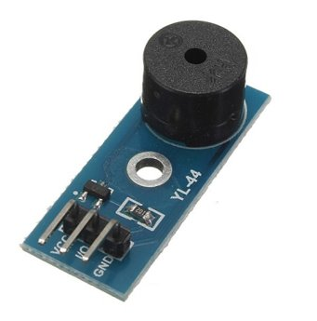
BUZZER
An Active Buzzer Alarm Module for Arduino is an audio signaling device, which may be mechanical, electromechanical, or piezoelectric.
An active buzzer rings out as long as it is electrified. Compared with a passive buzzer, it is a bit expensive but easier to control
Typical uses of buzzers include alarm devices, timers, and confirmation of user input such as a mouse click or keystroke.

Slide 22
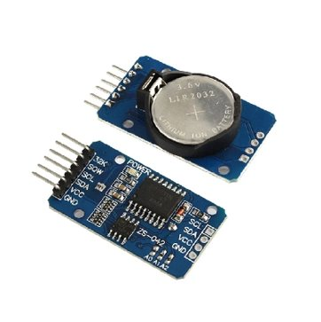
REAL-TIME CLOCK
RTC is an electronic device in the form of an Integrated Chip (IC).
The purpose of an RTC or a real-time clock is to provide precise time and date which can be used for various applications.
The RTC module is ideal in any time-critical applications like attendance systems, digital cameras, automated sprinkler systems, or a time and calendar display.

Slide 23
IMPLEMENTATION
The Arduino is programmed to turn on the specified LED on the box and to buzz at the required time.
The nurse/family member sets the timer with the help of the push buttons and specifies the compartment and the time it needs to be taken at.
The buzzer buzzes so the patient can take the specific medication at the required time.

Slide 24
RESULTS

Slide 25
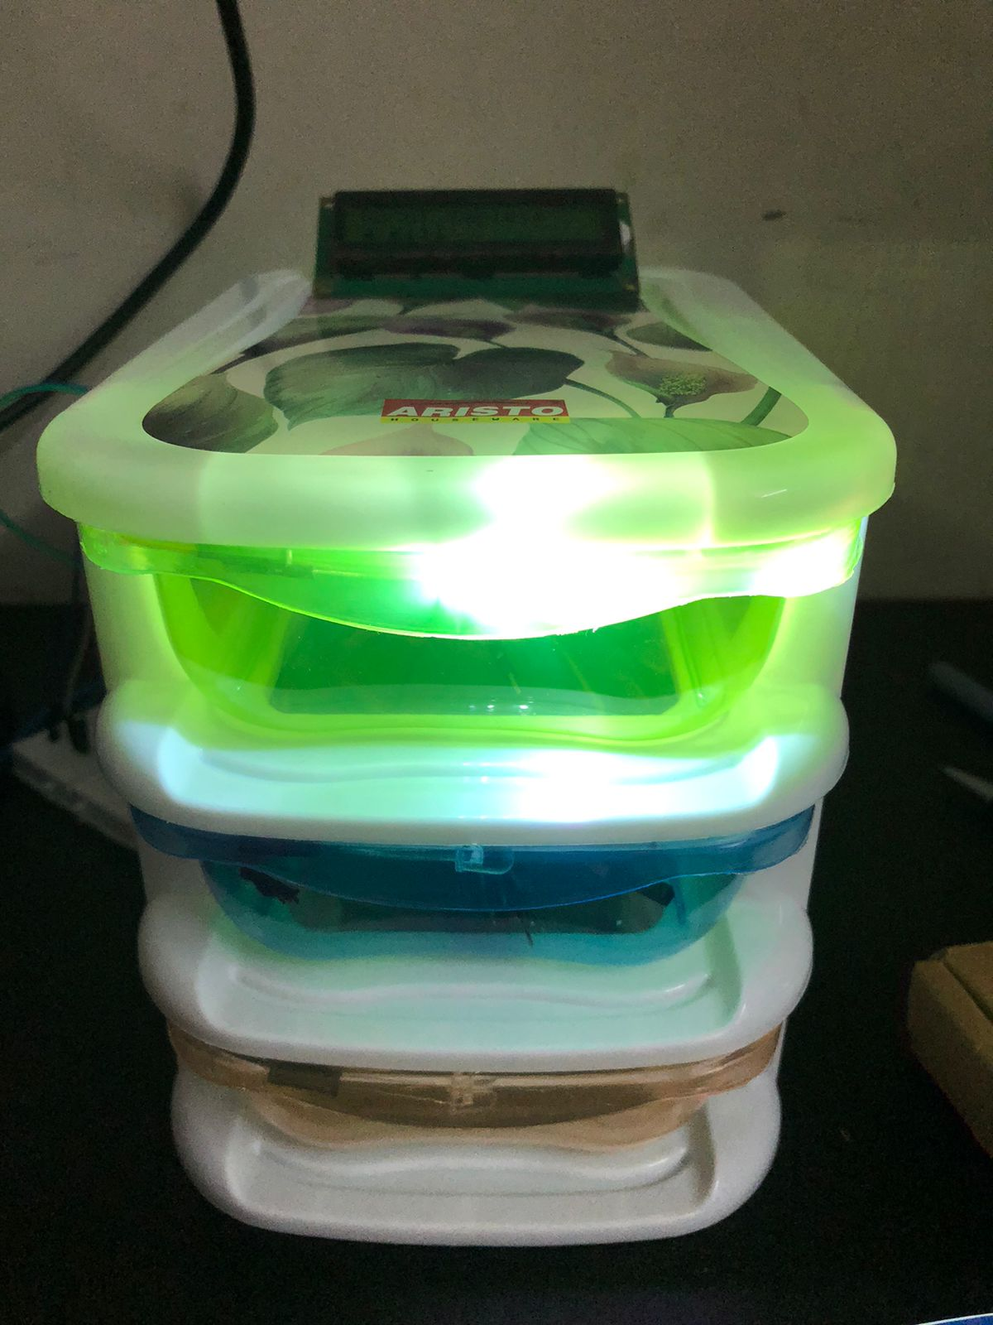
RESULTS
A functional Box with storage for medicine storage.
Automatic alarm system at the time of medication.
LCD to display the number of pills to be taken.
Medicine storage containers are illuminated according to the prescription.

Slide 26
CONCLUSION AND FUTURE SCOPE

Slide 27
CONCLUSION AND FUTURE SCOPE
The box would be portable and battery operated.
Connectivity with mobile for programming the prescription.
Authentication feature to avoid child misuse.
Mobile Application for monitoring the statistics of the medicines.
Integrate with other health care devices like blood pressure monitor

Slide 28
REFERENCES

Slide 29
REFERENCES
[1] Bhati, Sanjay, et al. "Smart medicine reminder box." IJSTE-International Journal of Science Technology & Engineering 3.10 (2017): 172-177.
[2] D.S. Abdul Minaam, M. Abd-ELfattah. "Smart drugs: Improving healthcare using Smart Pill Box for Medicine Reminder and Monitoring System". Future Computing and Informatics Journal 3 (2018) 443-456

Slide 30
THANK YOU

